Slide 1
Ewers’ Evidence for land sparing and potential mechanisms
Is this really justification for increased intensification?

Slide 2
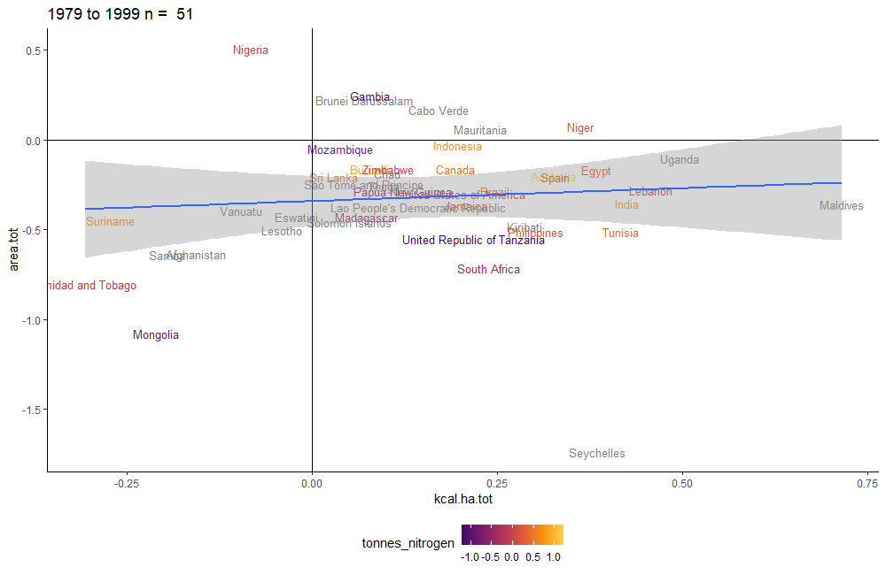
Original plot, with countries, nitrogen usage
Note: Trend is largely from countries with dropping production

Slide 3
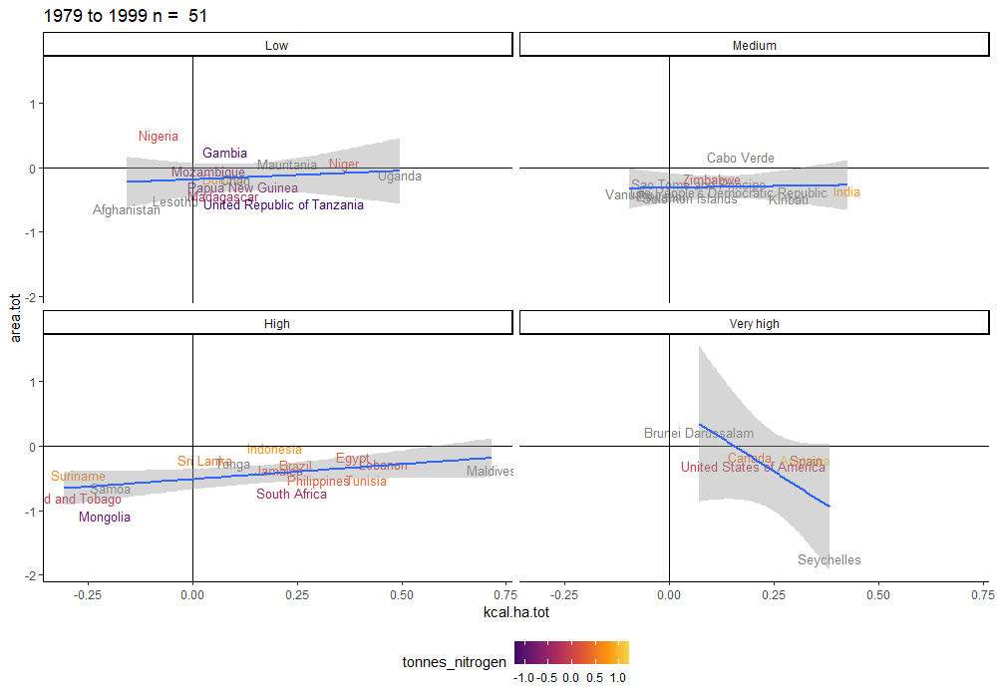
Splitting countries by development (HDI)
Land use in agriculture
Yield (kcal/h)

Slide 4
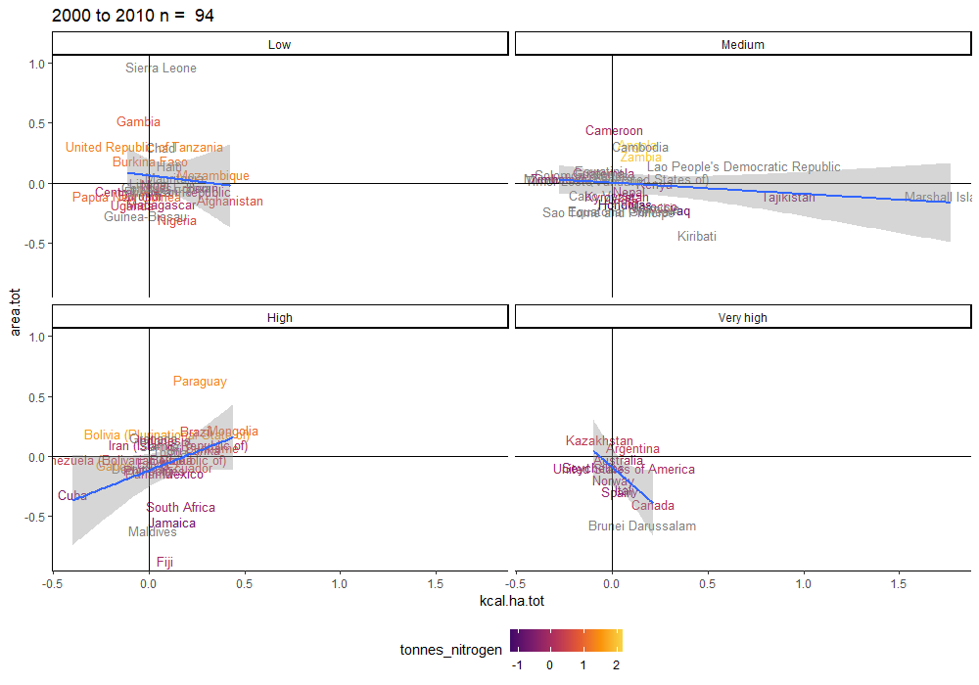
Years 2000-2010 by HDI, nitrogen use
Land use in agriculture
Yield (kcal/ha)

Slide 5
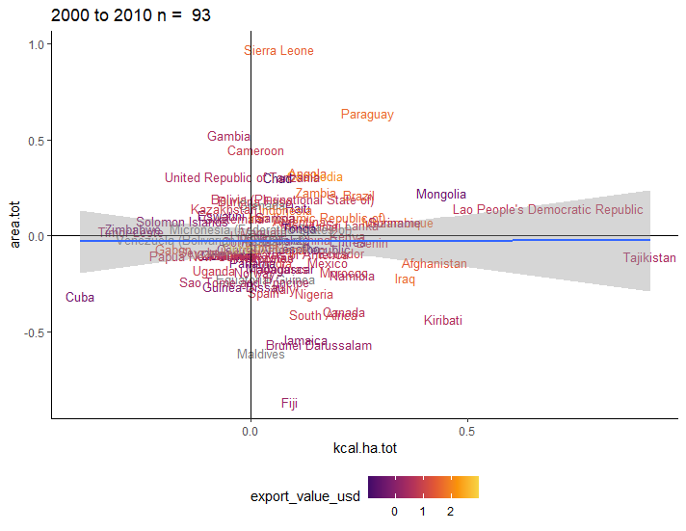
Years 2000-2010 by exports

Slide 6
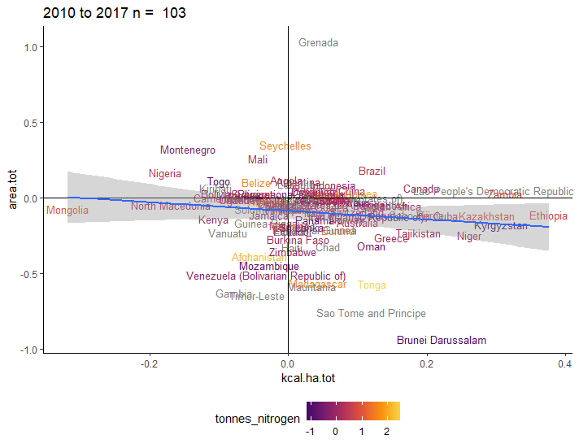
2010-2017 by nitrogen usage

Slide 7
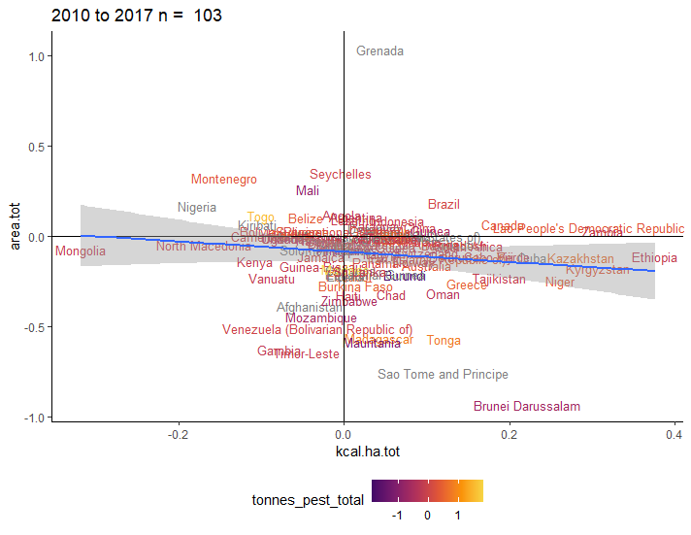
2010-2017 by pesticide use

Slide 8

2010-2017 by greenhouse gas emissions

